Slide 1
Beef and rams fattening
Produced by
Aishatu. Y. Girgiri (ass Prof.)

Slide 2
Introduction
Nigeria’s livestock resources consist of 14 million cattle, 34 million goats, 22 million sheep (Umar, 2007).
In Nigeria, large ruminants particularly cattle have been the major sources of domestic meat and milk supply.
Milk supply from other animals such as sheep, goats and camels is negligible (Ibeawuchi & Dalyop, 1995).
The world population will have reached 9 billion by 2050,
The demand for milk and meat products is expected to increase (FAO, 2010).
Demand has been increasing, due to increase in population
Livestock feed shortage is further worsened as grazing reserves and paths are continuously being converted to farm lands

Slide 3
Classes of Ruminant Animals
Ruminant animals are categorized into two main classes based on their body size namely,
The large ruminant animals and small ruminant animals.
Examples of large ruminants are cattle, water buffalo, giraffe, camel etc
While small ruminants are sheep, goat, antelope etc.

Slide 4
Cattle can also be typed or classified based on the main purpose of production.
Those specifically bred for milk production are called dairy cattle (e.g. Holstein/Friesian)
Those for meat are called beef cattle (e.g. Hereford).
Some cattle have dual or even triple-purpose functions. (dairy, beef production and draught). local breeds in Africa e.g. White Fulani, Sokoto Gudali etc

Slide 5
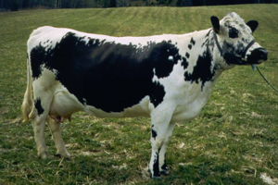
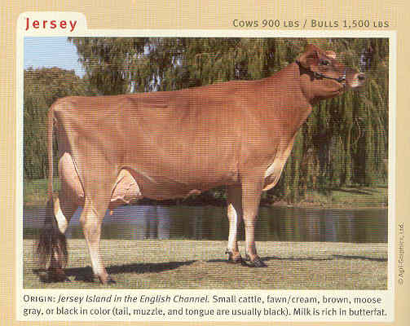
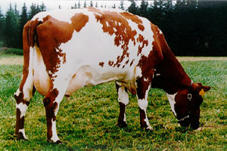
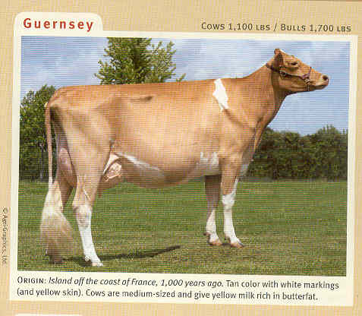
WORLD DAIRY BREEDS
Holstein.
.
Jersey
Ayshire.
Guernsey.

Slide 6
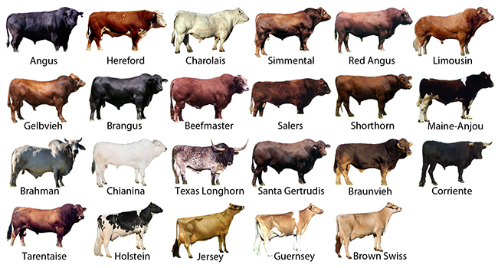
WORLD BEEF BREEDS.

Slide 7
local BREEDS
The recommended breeds for fattening are:
Red Bororo (Rahaji)
White Fulani (Bunaji)
Sokoto Gudali (Bokoloji)
Wadara (Shuwa Arab)
Kuri
Ambala

Slide 8
Cattle production in Nigeria
The various activities of the Nigerian beef.
These activities are, however, unorganised
Currently, however, very few of the 63 known processing plants are operating.
Those that are still functioning operate at less than 20% of capacity.

Slide 9
PROSPECTS OF BEEF AND RAM INDUSTRY
They offers employment opportunity to millions of Nigerians as
Nigeria has high prospects of increasing its cattle population.
- Improved health conditions and standard of living
- High economic growth rate
-Cattle serves as a source of farm power
-Hides provide raw material for the leather industry
-Hooves and bones provide raw material for industries
-The dungs provide manure for farmlands
-There is ready market since animal protein consumption per day (7g vs 35g).

Slide 10
Characteristics of Beef and Ram breed
The ultimate goal in a beef management program is to produce large quantities of high quality beef efficiency and profitably.
The basic conformation of the beef type animal is short, thick bones, thick muscles, long broad backs and square rumps carrying more of the valued flesh.
The ideal beef conformation has been described as a “parallelogram” or a “block” conformation.
Animals with long limbs, narrow flat sided barrels and small rumps are not desirable as beef animals.

Slide 11
Selection of Beef and Ramm
To insure a profitable income from fattening, these factors are to be considered:
Age-
Sex-
Disposition-.
Constitution- and Vigor-
Breed
Health Condition of the Animal -

Slide 12
General Management practices
Newly arrived feeder stock should first be confined.
A week after arrival, deworming and spraying
The feeding area should be always kept clean and drained
Always watch for signs of illness
The animal should be vaccinated against
Water should be available at all times.
Feeding of concentrate should be increased gradually to minimize the occurrence of rumentis, scouring and bloating.
Animals in the backyard affected with disease should be removed at once from the pen.
Mineral supplements and growth stimulants are added to the feed as needed.

Slide 13
feeding
In feeding cattle there are two main goals:
Determine the amount of each nutrient the animal needs and
Determine how much and what kind of feed should be fed to cattle to supply their nutrient needs.
The principle guide should be:
1) 3-4% Body weight
2) 60:40 energy: protein ratio
3) Mineral

Slide 14
Importance and benefit of grass storage
Farmers can take following advantages by storing grasses:
· Availability of grasses in the all seasons.
· No extra cost for purchasing additional feeds.
· Off-season usage of seasonal extra produces of grasses.
· Nutritious elements of grasses can be kept.
· Time and labor will be reduced for grass collection in the dry season.

Slide 15
Method of Silage making
Silage is made through fermentation and it can be stored more than one year.
· Selection of grasses
· Check status of moisture and growing stage
· Grass cutting and collection
· Cut grasses in pieces
· Put into bag and make it air tight

Slide 16
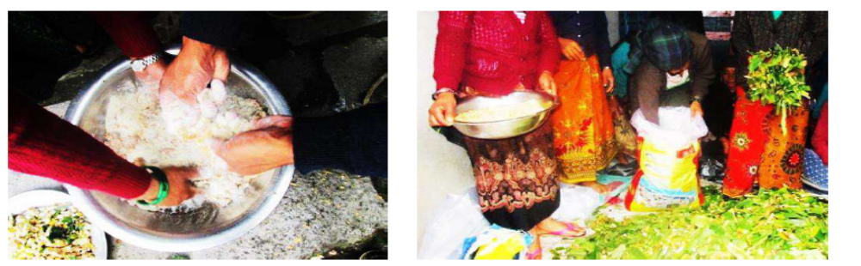
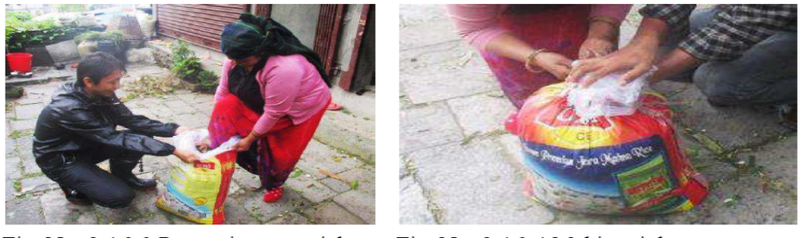

Slide 17
Standardization of feed ingredients | 0
1. Millet Stover (MS) 1 mudu = 0.5kg
2. Wheat Straw (WS) 1 mudu = 0.5kg
3. Millet husk (MH) 1 mudu = 0.5kg
4. Cowpea husk (CH) 1 mudu = 0.5kg
5. Wheat offal (WO) 1 mudu = 1kg
6. Maize bran (MB) 1 mudu = 1kg
7. Sorghum husk (MH)1 mudu = 1kg
8. Cotton S. C. (CSC) 1 mudu = 2kg
9. Copra meal (CM) 1 mudu = 2kg
10. Poultry litter (PL) 1 mudu = 2kg

Slide 18
Beef and Ram HOUSING
Housing is an integral part of management,
1. Theft or loss to accidents and predators
2. Sickness and death of Animals
3. Poor reproduction and loss of young ones
4. Feed wastage
5. Difficulty in catching Animals on the farm or difficulty with neighbors
6. Uncontrolled breeding
7. Lack of records
8. Poor general management

Slide 19
There are six key housing aspects of cow health and wellbeing, namely:
1. Water, with access to clean, potable water at least 21 hr/day.
2. Light, with at least 6 hr/day of darkness.
3. Air, that is fresh and clean.
4. Rest, with a dry and comfortable place to lie down.
5. Space, so cows can walk to feed and water troughs from their free stalls without fear.
6. Feed, in that cows can eat a palatable and well-formulated feed.

Slide 20
Systems of commercial beef cattle production
(1) the cow calf segment
(2) the back grounding or stocker phase of production
(3) the finishing phase

Slide 21
THANK YOU
FOR
LISTENING

